Slide 1

Building Data Science Solutions using Python

Slide 2

From Where this comes

Slide 3
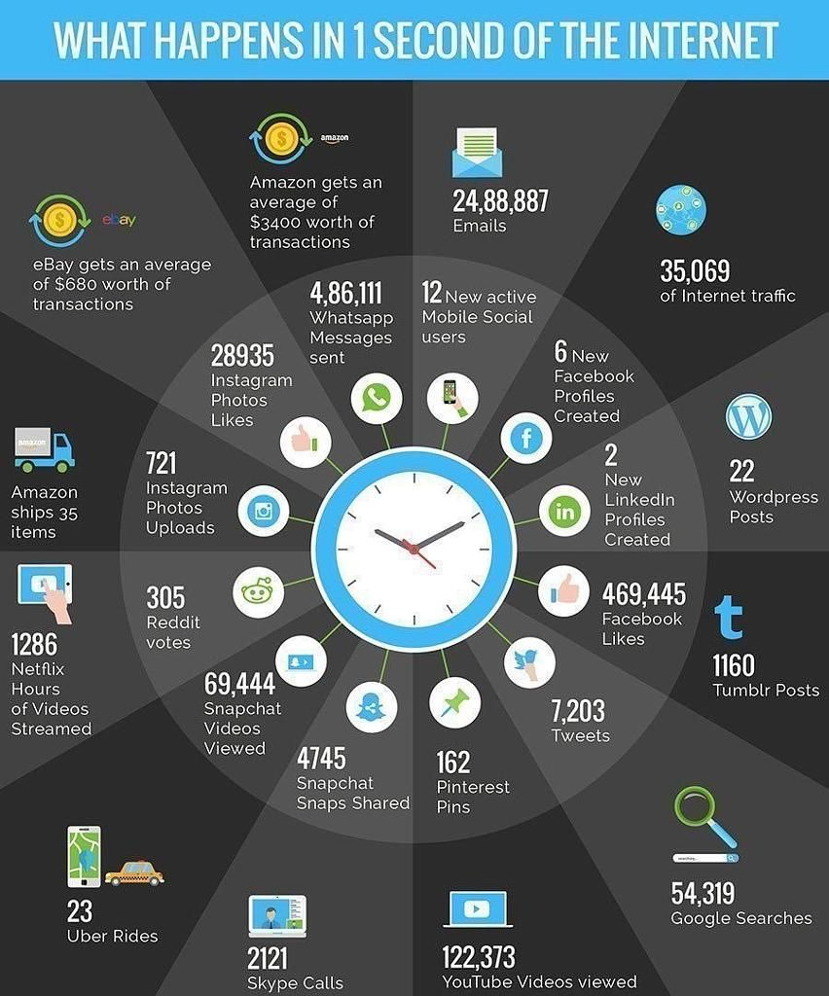



Slide 4
Data Science
Data science is an interdisciplinary field that uses scientific methods, processes, algorithms and systems to extract knowledge and insights from structured and unstructured data, and apply knowledge and actionable insights from data across a broad range of application domains.
Computation Engine
Data Storage
Fundamental Theories
Subject Matter Expertise

Slide 5
Session Content
https://github.com/anantawasthi/VAC
Feel free to write
anant.awasthi@outlook.com

